Slide 1

Identification of Environmental Parameters for Seaweed Cultivation
By
Prakash S
M.Tech Aquacultural Engineering, IIT Kharagpur.

Slide 2
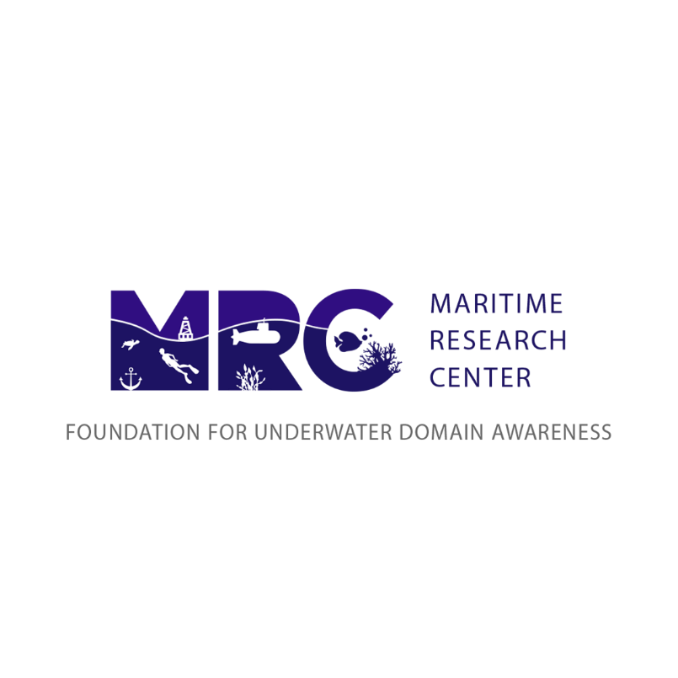
Aim & Objective
To study the effect of different Environmental and Hydrodynamic parameters on the growth of Seaweed

Slide 3
Contents
Culture methods & Why to understand growth parameters?
Beneficiaries & Research Gaps
Generalized ideal conditions
Spatial distribution of good sites for seaweed growth
Findings from the literature
Conclusion & References

Slide 4
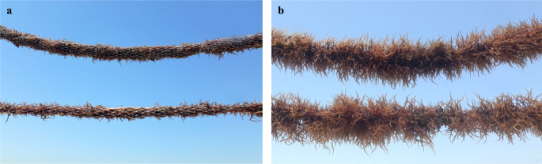
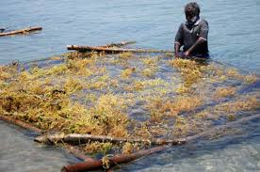
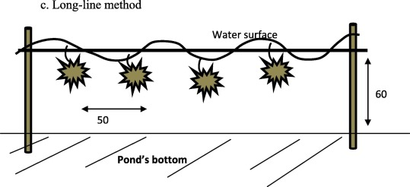
CULTURE METHODS
Tube Net method
Bamboo Raft method
Longline or Monoline method
The tube net method can be adopted in locations
with higher wave action in coastal states like
Andhra Pradesh and Gujarat.
The Floating bamboo raft method is ideal in locations
which are calm and shallow.
In locations characterized by moderate wave
action, shallow depth, and the presence of less
herbivorous fishes, longline or monoline method of seaweed farming is ideal.

Slide 5
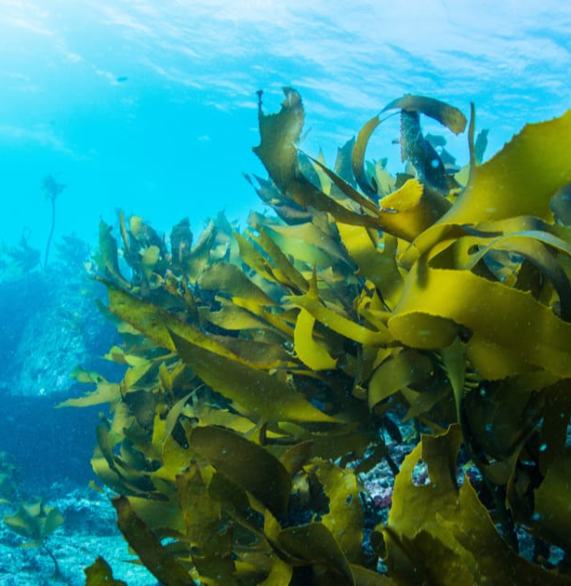
Why to understand growth parameters?
Site selection plays an important role in the success of any sustained commercial farming activity.
It significantly influences the economic returns and viability of the farming system.
For good biomass production, & for good economic return.
This basic understanding can be able to save farmer/entrepreneur/govt agencies from getting failure in seaweed farming.

Slide 6
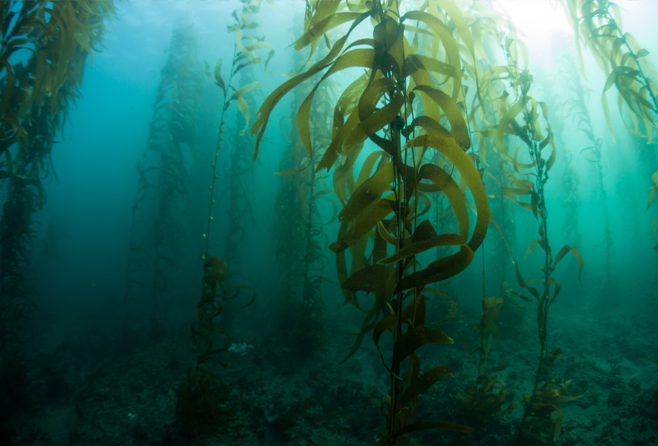
GROWTH PARAMETERS
Sea Surface Temperature
Salinity
pH , Light Irradiance
Nutrient availability
Water depth
Wave current

Slide 7


Ideal Conditions
• Stable seawater with not less than 30 ppt salinity
• Sandy/ rocky bottom with transparent water
• Ideal temperature 26-30ºC.
• The area should have a minimum 1.0 m water depth during low tide.
• Area with mild water currents is preferred.
• pH = 6.5 to 8.5
• Nutrient = Sites with sufficient Nitrate-Nitrogen and phosphorous
Generally 0.018-0.065 ppm of Nitrogen and 0.0017-0.0074 ppm of Phosphate.

Slide 8
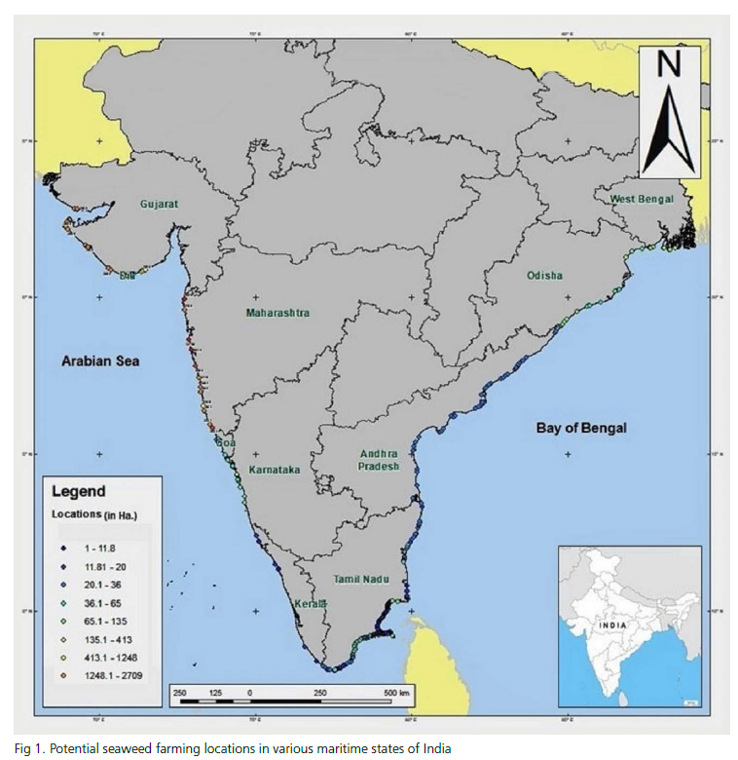
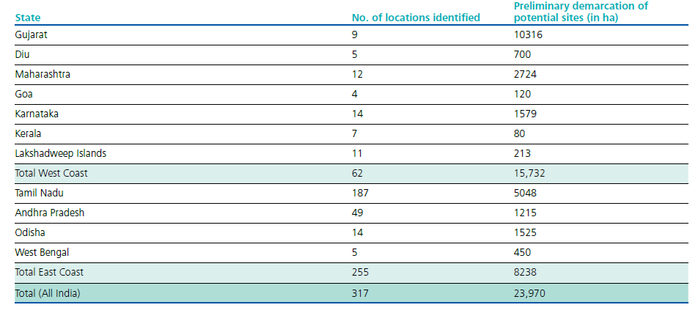
Spatial distribution of cultivable sites
An all India preliminary site selection survey suitable for seaweed farming was conducted by ICAR-CMFRI along all maritime states of India.
From this survey a total of 23,970 ha area were identified as potential seaweed farming along the Indian coast.
Source: Johnson et al., 2020.

Slide 9
Findings
S.no | Seaweed species | Temperature (°C) | Salinity (ppt) | Additional findings
1 | Kappaphycus alvarezii | 26-28 | 30-33 | Floating cage method is preferred
2 | Gracilaria edulis | 24-28 | 27-32 | Cultivation in subtidal region is preferrable
3 | G. crassa | 25 | 35 | -
4 | G. arcuata | 20 | 30 | -
5 | G. foliifera | 25 | 30 | -
6 | G. corticata | 25 | 25 | -
7 | Hypnea cervicornis | 25 | 25 | -
8 | Gracilaria tenuistipitata | 20 | 20 | pH of around 6.5 gives better growth rate
9 | Gracilaria dura | 26-31 | 30-36 | Polypropylene net method is preferred
10 | Gelidiella acerosa | 25-33 | 28-38 | Suspended stone method is preferred

Slide 10
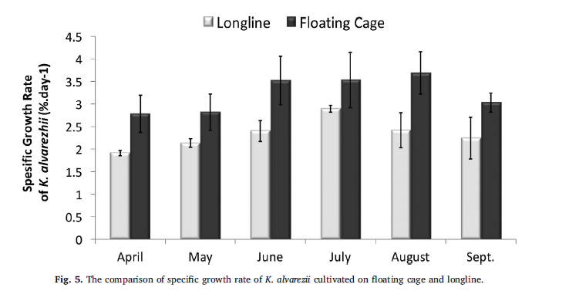
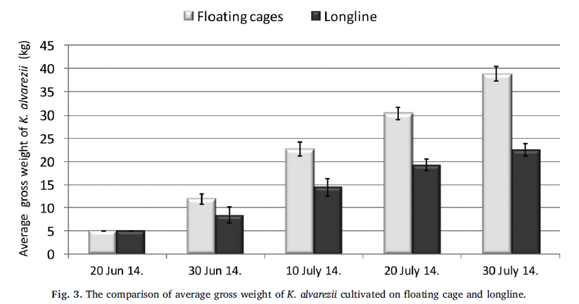
The study aims to reveal growth of K. alvarezii cultivated in floating cages and longline.
Floating cage can provide space and a good protection for propagule to thrive cause avoiding from herbivorous. Good growth occurs during June, July and August when current velocity increases and nitrate and phosphate appear higher than other months.

Slide 11
Species yet to be researched on
G.arcuata
Gelidiella indica
G.verrucosa
G.vorticata
Hypnea valentiae
Sarconema furcellatum
Acanthophora spicifera
Laurencia papillosa
Sargassum wightii
Sargassum myriocystum
Hypnea musiformis
Hypnea musiformis
Sargassum tenerrimum
Sargassum duplicatum
Turbinaria conoides
Turbinaria ornata
Turbinaria decurrens
Cystoseira trinodis
Hormophysa triquetra
Enteromorpha compressa
Caulerpa racemosa
Caulerpa sertuiarioides
Chaetomorpha unoides
Cladophora fascicularis

Slide 12
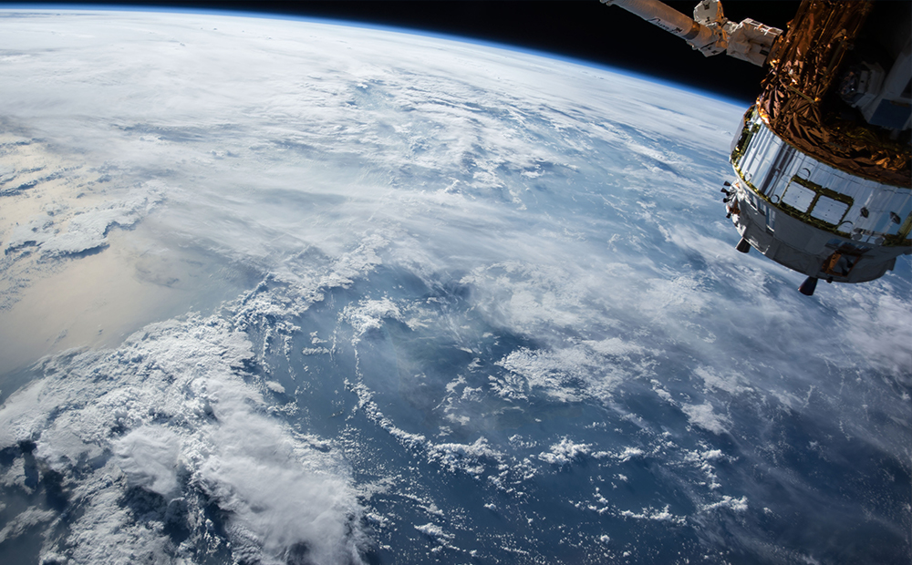



THINGS TO ADDRESS !
Detailed marine spatial Analysis to ensure a good site for seaweed cultivation.
Innovation
Research
Innovations in seeding Technology
Finance
Extensive research analysis and tests are to be done on the culturable seaweed species of India.
Financial support to Farmers and entrepreneurs.

Slide 13
Outcomes of the study
Cultivation methods and culturing parameters were studied
Importance of maintaining parameters for optimal growth were analyzed
The data from this study will be the base while creating a user-friendly online tool/website.
The tool will be useful for all entrepreneurs, farmers and Govt agencies in better understanding of seaweed and its growth.

Slide 14
References
Ma’ruf Kasim and Ahmad Mustafa. “Comparison growth of Kappaphycus alvarezii (Rhodophyta, Solieriaceae) cultivation in floating cage and longline in Indonesia”. Aquaculture Reports 6 (2017) 49–55.
SN Raikar,M Iima and Y Fujita.(2001). “Effect of temperature, salinity and light intensity on the growth of Gracilaria spp. (Gracilariales, Rhodophyta) from Japan, Malaysia and India”. Indian Journal of Marine Sciences Vol. 30. June, 2001, pp. 98-104.
Ravi S. Baghel, Puja Kumari, C. R. K. Reddy and Bhavanath Jha. (2014) “Growth, pigments, and biochemical composition of marine red alga Gracilaria crassa”. J Appl Phycol 26:2143–2150.
ICAR-CMFRI | Marine Fisheries Information Service Technical & Extension Series No. 246, 2020

Slide 15
Lanping Ding, Yuanyuan Ma, Bingxin Huang, and Shanwen Chen. “Effects of Seawater Salinity and Temperature on Growth and Pigment Contents in Hypnea cervicornis J. Agardh (Gigartinales, Rhodophyta)”. Hindawi Publishing Corporation BioMed Research International Volume 2013.
M. Ganesan, Nivedita Sahu and K. Eswaran “Raft culture of Gracilaria edulis in open sea along the south-eastern coast of India”. Aquaculture 321 (2011).
V. Veeragurunathan, K. Eswarana, K.R. Saminathana, Vaibhav A. Mantri, J. Malar vizhi, G. Ajay, Bhavanath Jha. “Feasibility of Gracilaria dura cultivation in the open sea on the Southeastern coast of India”. Aquaculture 438 (2015).
M. Ganesan, S.Thiruppathi, K.Eswaran,C.R.K. Reddy, B. Jha. “Development of an improved method of cultivation to obtain high biomass of the red alga Gelidiella acerosa (Gelidiales, Rhodophyta) in the open sea”. Biomass and Bioenergy 35 (2011).
V. Veeragurunathan, K.Eswaran, J.Malarvizhi and M. Gobalakrishnan. “Cultivation of Gracilaria dura in the open sea along the southeast coast of India”. J Appl Phycol (2015) 27:2353–2365.
Chew-Hock Yu, Phaik-Eem Lim and Siew-Moi Phang. “Effects of irradiance and salinity on the growth
of carpospore-derived tetrasporophytes of Gracilaria edulis and Gracilaria tenuistipitata var liui (Rhodophyta)” J Appl Phycol (2013) 25:787–794.

Slide 16
THANK-YOU

